Slide 1
MONTE CARLO UNCERTAINTY ANALYSIS OF OZONE TRENDS FROM 1990 THROUGH TO 2030
Dick Derwent
rdsientific, Newbury, United Kingdom
16th TFMM Meeting, Crakow, Poland
6th May 2015
The development of the PTM model has been supported by the UK Department for Environment, Food and Rural Affairs

Slide 2
HAVE REDUCTIONS IN OZONE PRECURSOR EMISSIONS DELIVERED OBSERVED TRENDS IN OZONE ACROSS EUROPE?
In situ high frequency observations of 25 VOCs have shown marked downwards trends in UK since 1993
These trends accurately agree with European VOC emission inventories
Do these inventory trends produce modelled peak ozone trends that agree with the observations?
How are uncertainties in models taken into account?

Slide 3
OBSERVED TRENDS IN TOTAL AROMATIC VOCS IN THE UK

Slide 4
OBSERVED TRENDS IN ALKENE VOCs IN THE UK

Slide 5
OBSERVED TOTAL VOC CONCENTRATIONS ACROSS THE UK

Slide 6
COMPARISON OF OBSERVED AND INVENTORY TRENDS

Slide 7
HOW DO THESE VOC TRENDS DRIVE OZONE TRENDS?
Because these inventory trends were calculated using the emission inventory guidebooks we can be sure that they apply widely across Europe
We have applied the VOC and NO_{x} inventory trends in the Photochemical Trajectory Model
Monte Carlo uncertainty analysis has been applied because of the huge uncertainties in ozone models
Meteorological data have been kept constant at 2013 conditions

Slide 8
DAILY MAXIMUM 8-HOUR RUNNING MEAN OZONE LEVELS AT LULLINGTON HEATH DURING 2013
Episode peak of 65 ppb

Slide 9
MONTE CARLO UNCERTAINTY ANALYSIS
assign subjective uncertainty ranges for each input parameter
sample a large number of independent multiple air mass trajectories from the NAME dispersion model arriving at Lullington Heath on 23rd August 2013 between 15:00 and 15:15z
perform 10,000 UK PTM runs to sample all the uncertain parameters randomly and simultaneously
select only those parameter choices that predict correctly the O₃ observations at Lullington Heath

Slide 10
MONTE CARLO ANALYSIS OF ALL PTM MODEL UNCERTAINTIES
all dry deposition velocities: x 0 – 1
longitude and latitude of position: ± 0.45º x 1-3; ± 0.28º
NH₃ VOC NO_{x} SO₂ CO CH₄ emissions: x ± factor of 2
VOC speciation: x ± factor of 2
isoprene emissions: x ± factor of 4
initial conditions: x ± factor of 1.5
boundary layer depth: x ± factor of 2
relative humidity: x ± factor of 2
temperature: ± 0 – 3 ºC
choice of NAME trajectory: select 1 out of 30 independent choices
all rate coefficients: ± 30 %
These are all subjective estimates of the uncertainties of input parameters relative to their ‘best estimate’ values.

Slide 11
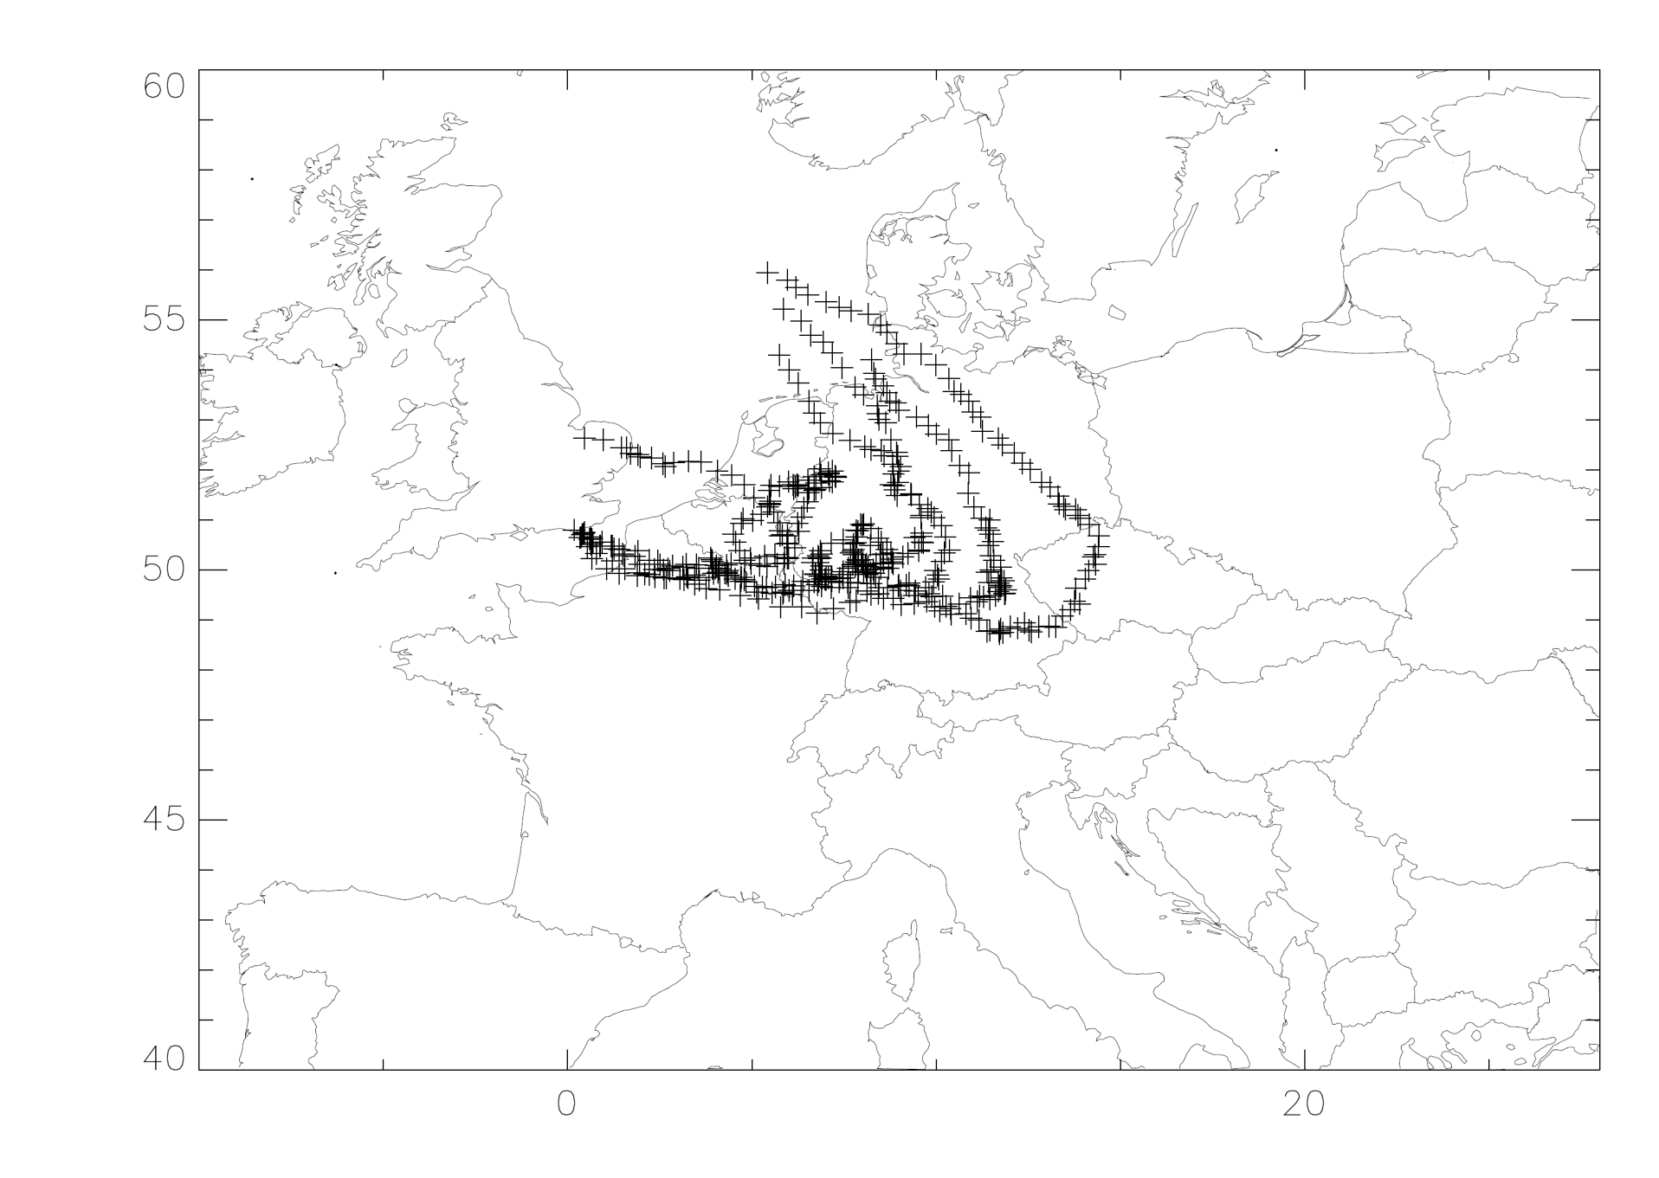
BACK-TRACK AIR MASS TRAJECTORIES FOR 23rd AUGUST 2013

Slide 12
MONTE CARLO ANALYSIS TO FIND ACCEPTABLE PARAMETER SETS
Fixed input for 23rd August 2013
PTM model
Monte Carlo sampled parameter input
Generate 10,000 sets of outputs
Fail
Check against O₃ observations
Pass
Reject parameter sets
Store parameter sets
1018 acceptable parameter sets

Slide 13
PROBABILISTIC UNCERTAINTY ANALYSIS IN A POLICY CONTEXT
PTM model
Monte Carlo analysis
A single model run is replaced by 1018 runs
PTM model with 1018 acceptable sets of parameters
No solvent controls case
No paint controls case
Base case

Slide 14
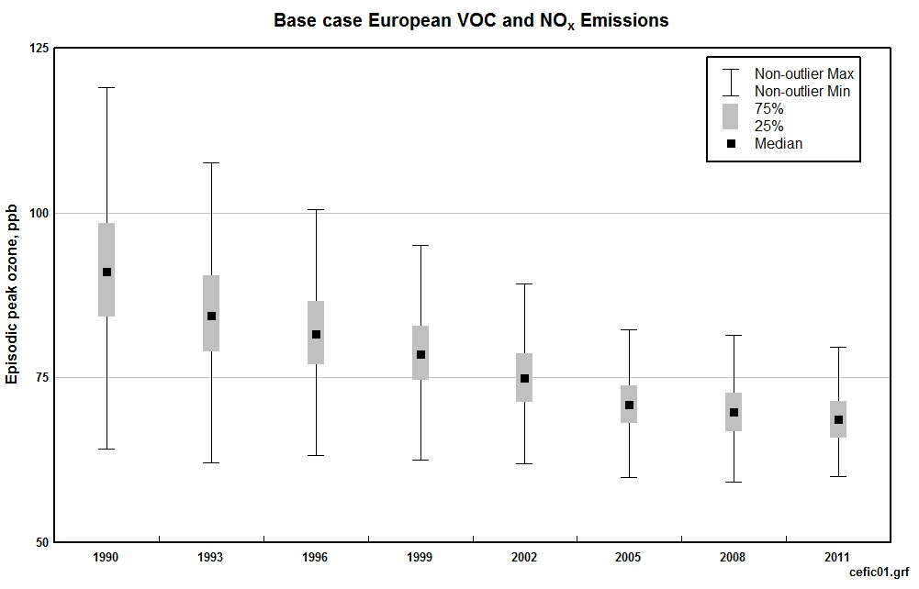
IMPACT OF REDUCTIONS IN VOC AND NO_{x} EMISSIONS
World Health Organisation 50 ppb 8-hour ozone guideline

Slide 15
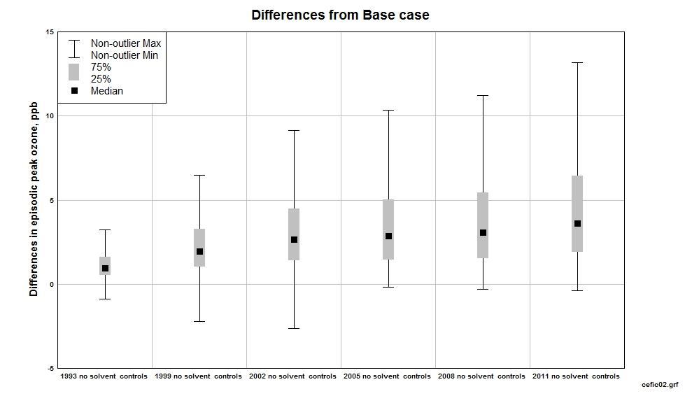
WHAT HAS BEEN THE CONTRIBUTION FROM REDUCTIONS IN SOLVENT EMISSIONS ?

Slide 16
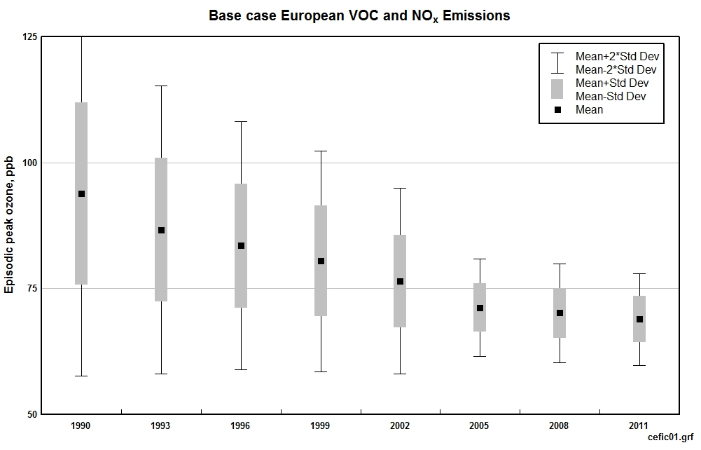
Highest 8-hour running mean in ppb at Lullington Heath

Slide 17
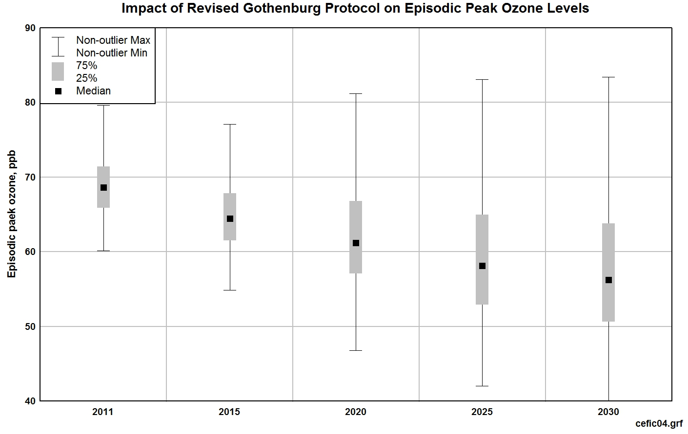
WHAT IS THE LIKELY IMPACT OF THE REVISED GOTHENBURG PROTOCOL OVER THE PERIOD UP TO 2030 ?
World Health Organisation 8-hour ozone air quality guideline
13% chance of meeting AQG
31% chance of meeting AQG
41% chance of meeting AQG

Slide 18
CONCLUSIONS
VOC concentrations have shown strong downwards (≈ 20% per year) trends at all UK sites, kerbside, urban background and EMEP rural sites
These observed trends agree closely with the UK VOC emission inventory trends which take into account the fitting of three-way catalysts and evaporative canisters
These emission trends when applied within a Photochemical Trajectory Model with full treatment of model input uncertainties agree closely with episodic peak ozone observations
We can be sure that the vehicle emission controls and the EU Solvents Emission Directive have reduced peak ozone levels

